Slide 1
Vertical’s
Do They Really Work?
By Kevan Nason
N4XL

Slide 2
References
Low Band DXing, ON4UN, Fifth Edition
ARRL Antenna Book, Various
Elevation and Pseudo-Brewster Angle Formation of Ground-Mounted Vertical Antennas, Robert J. Zavrel Jr., QEX Mar/April 2016
DXpedition Antennas- Vertical vs. Yagi, N6PSE https://n6pse.wordpress.com/2014/02/21/dxpedition-antennas-vertical-vs-yagi/

Slide 3
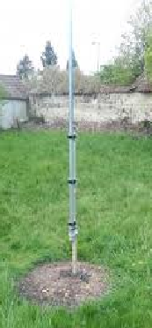
“They radiate equally badly in all directions. I wouldn’t own one. Save your money and build a dipole.”
Walter* once told me:
* Not his real name
Notes:
Experience of Audience compared to me
Looking beyond what people normally think of as how to bust a pileup
More contesting oriented than you might be used to

Slide 4
“When we were motoring to Rotuma Island for the 3D2R DXpedition in 2011, I experienced just how wonderful a vertical at/in salt water could be.”
A Dxpedition member once said:
https://n6pse.wordpress.com/2014/02/21/dxpedition-antennas-vertical-vs-yagi/
Notes:
Experience of Audience compared to me
Looking beyond what people normally think of as how to bust a pileup
More contesting oriented than you might be used to

Slide 5
So the question is not
“Do they work?”
It is really:
“How can I make it work and is it worth the trouble?”
Notes:
Experience of Audience compared to me
Looking beyond what people normally think of as how to bust a pileup
More contesting oriented than you might be used to

Slide 6
Types of Verticals
Who agrees with Walter and would never own or recommend a vertical?
Notes:
Experience of Audience compared to me
Looking beyond what people normally think of as how to bust a pileup
More contesting oriented than you might be used to

Slide 7
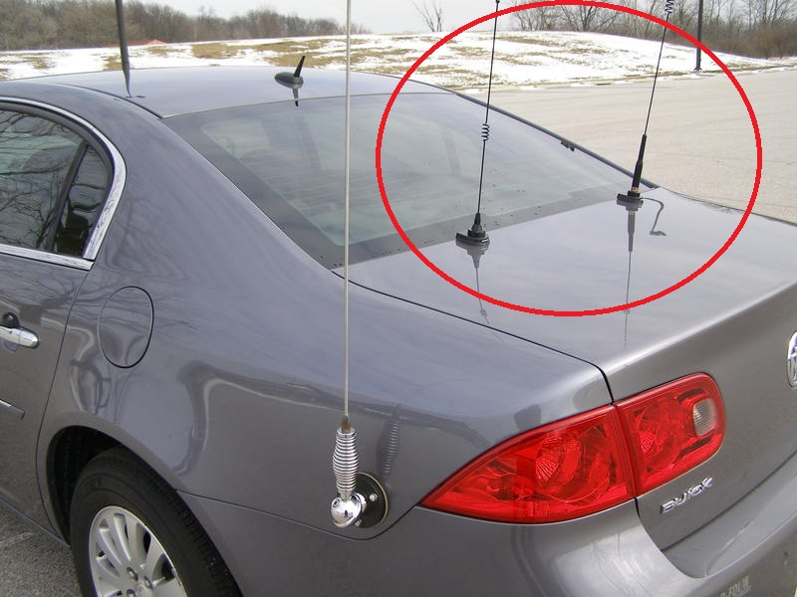
Types of Verticals
Notes:
Experience of Audience compared to me
Looking beyond what people normally think of as how to bust a pileup
More contesting oriented than you might be used to

Slide 8
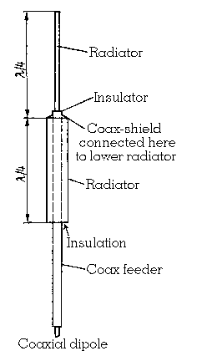
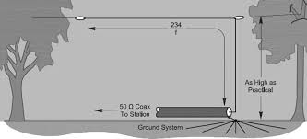
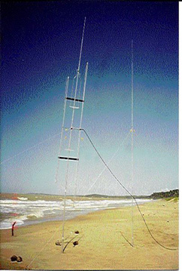
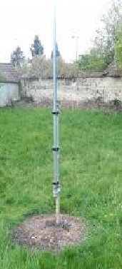
Types of Verticals
Notes:
Experience of Audience compared to me
Looking beyond what people normally think of as how to bust a pileup
More contesting oriented than you might be used to

Slide 9
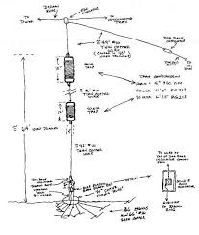
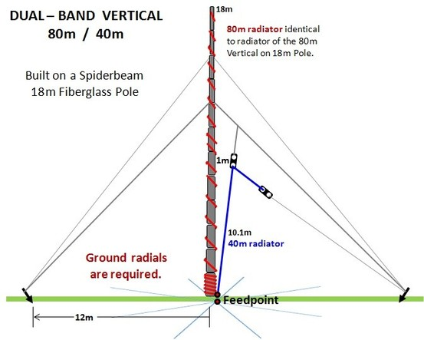
Types of Verticals
Notes:
Experience of Audience compared to me
Looking beyond what people normally think of as how to bust a pileup
More contesting oriented than you might be used to

Slide 10
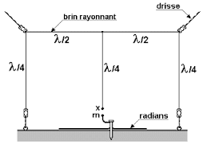
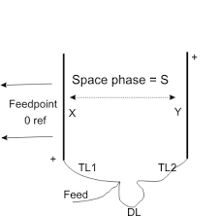
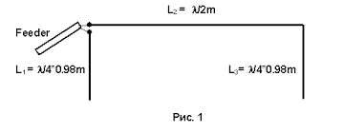
Types of Verticals
Notes:
Experience of Audience compared to me
Looking beyond what people normally think of as how to bust a pileup
More contesting oriented than you might be used to

Slide 11
Why Use a Vertical?
Want to work DX but can’t put up a high tower (particularly on low bands)
No trees to hang dipoles from
Want omnidirectional coverage, but existing trees would only allow a low dipole.
More pleasing to the eye than a tower (at least for some!)
Second hand verticals are fairly inexpensive. Easy to build your own with just wire

Slide 12
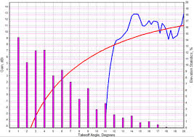
Why Use a Vertical?
Take off angles and antenna gain

Slide 13
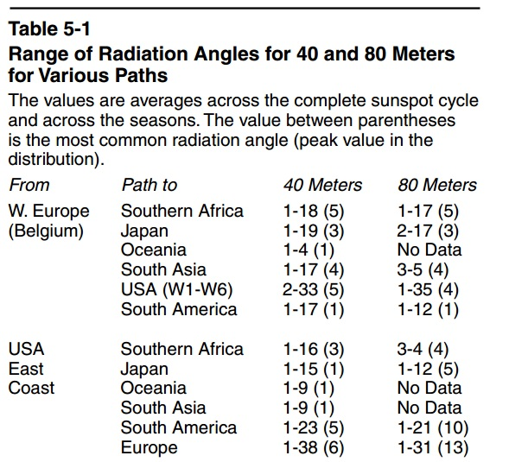
Why Use a Vertical?
40 and 80 meter take off angles

Slide 14
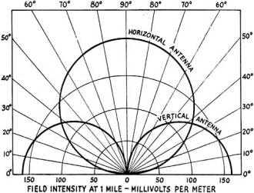
Why Use a Vertical?
From 1952 QST Article
These would be nice patterns to have in the real world

Slide 15
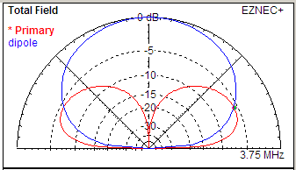
Why Use a Vertical?
80 mtr Dipole vs. Vertical

Slide 16
Comparison
Vert pattern has less gain over real earth
Gain can be significant at low angles – i.e.: DX
Vertical suppresses interference from stronger and closer stations – you can “hear” DX better
Low Dipole vs Vertical over average ground

Slide 17
Comparison
In many cases a low dipole is a better choice than a vertical
Make a Vertical work best by improving that low angle gain
Low Dipole vs Vertical over average ground

Slide 18
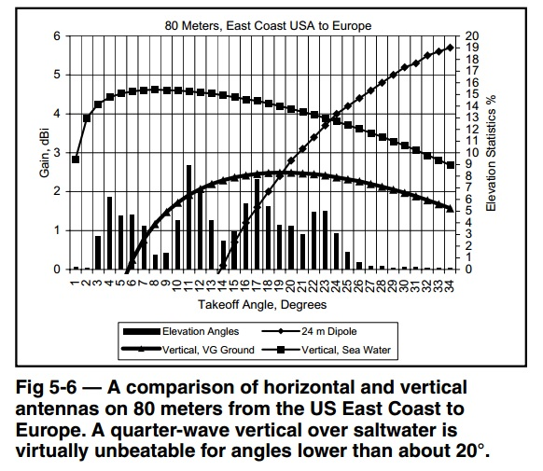
Antenna efficiency
The type of ground around a vertical is very important

Slide 19
Antenna efficiency
Radiation Resistance
  Your transmitter generates 100 watts. Where does it go?
  Some, hopefully most, is radiated as a signal
  Radiation resistance (referred to a certain point in an antenna system) is the resistance, which if inserted at that point, would dissipate the same energy as is actually radiated from the antenna

Slide 20
Antenna efficiency
Antenna efficiency
  The antenna efficiency of an antenna is simply the ratio of power radiated from that antenna to the power applied to it.
  Any energy that is not radiated will be converted into heat in the lossy parts of the antenna. Something in the antenna must consume the power.

Slide 21
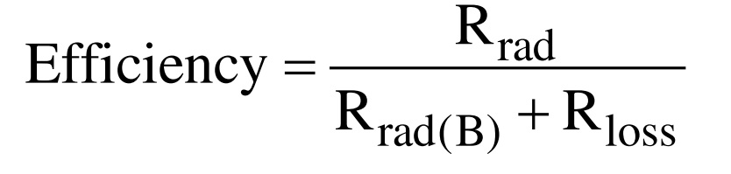
Antenna efficiency
The efficiency of an antenna is expressed as follows:
Where Rrad (B) is the radiation resistance of the antenna and Rloss is the total equivalent loss resistance of all elements of the antenna (resistance losses, dielectric losses, loading coils, etc).

Slide 22
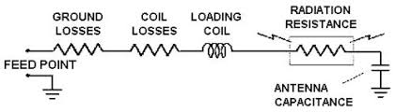
Antenna efficiency
To make a vertical more efficient you must either increase radiation resistance or decrease loss resistance

Slide 23
Antenna efficiency
How lower loss resistance?
  Use aluminum or copper instead of steel
  Avoid traps if possible and/or use good coils
  Repair or replace loose or corroded parts
  REDUCE GROUND LOSSES

Slide 24
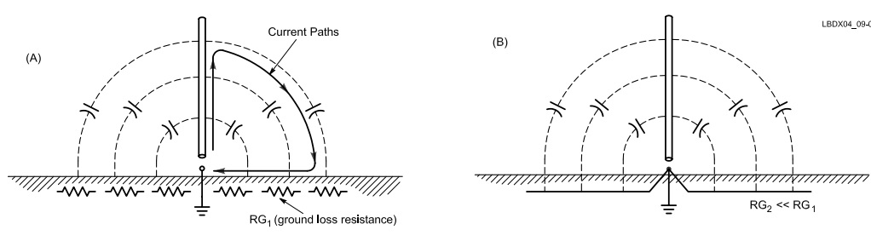
Antenna efficiency

Slide 25
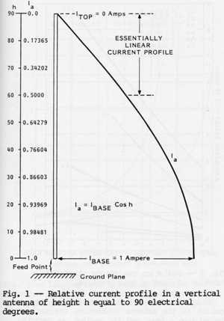
Antenna efficiency
Radiation occurs most where current is strongest
Current is strongest at the base of a ¼ wave vertical
A lot of the radio wave is dissipated into the ground

Slide 26
Antenna efficiency
Using radials to minimize ground loss
  Use low resistance radials to return the signal current to the base of the antenna instead of trying to use the high resistance earth
  The more radials there are the less signal heats the earth so the lower the ground loss.
  How many radials do you need?

Slide 27
Antenna efficiency
  Conventional wisdom says 120 half wave radials
  Hams who measured these things say 32 are good. 64 is better. >64 gives less and less improvement
  Wire size of radials not important. 18 gage is good
  Insulated or not doesn’t matter
  Use copper. Other metals dissolve fairly quickly in acidic earth
  ¼ wave good, but length not critically important. Put out whatever number and length wires you can afford

Slide 28
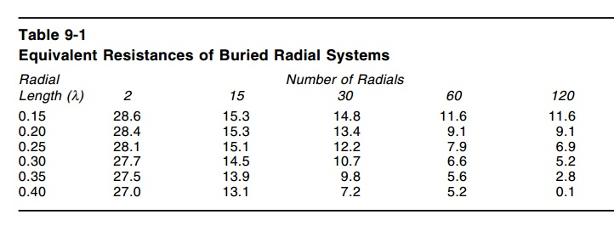
Antenna efficiency

Slide 29
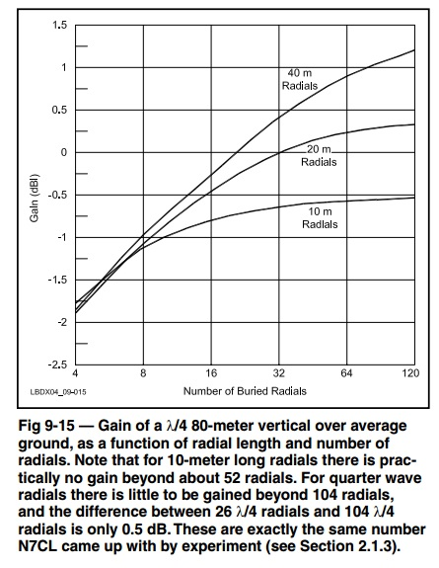

Slide 30
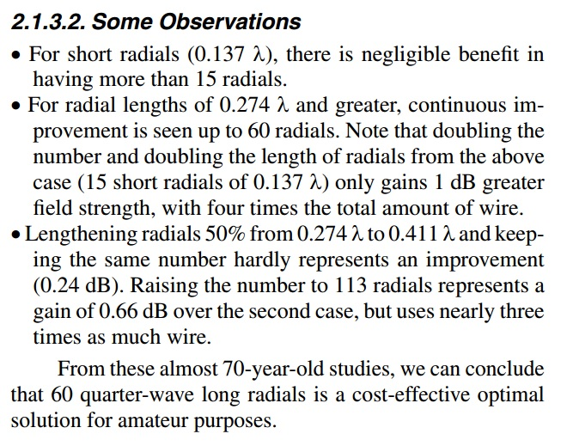
Antenna efficiency

Slide 31
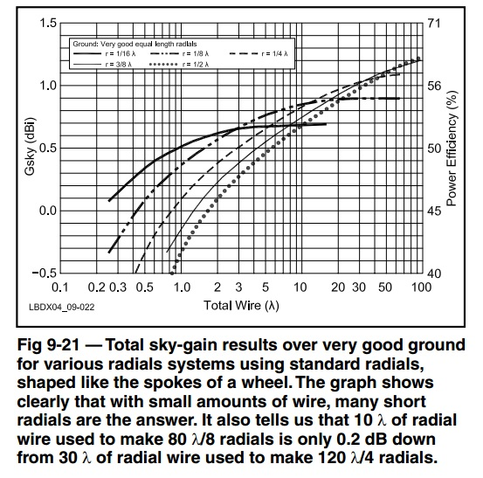
Antenna efficiency

Slide 32
Antenna efficiency
Alternative to ground radials:
  Raise the whole antenna, radials and all, up in the air.
  The elevated radials will screen the earth so the antenna doesn’t “see” it as well
  Length of radials is important – now critical part of the antenna and acts just like half of a dipole
  Height of antenna also plays a role

Slide 33
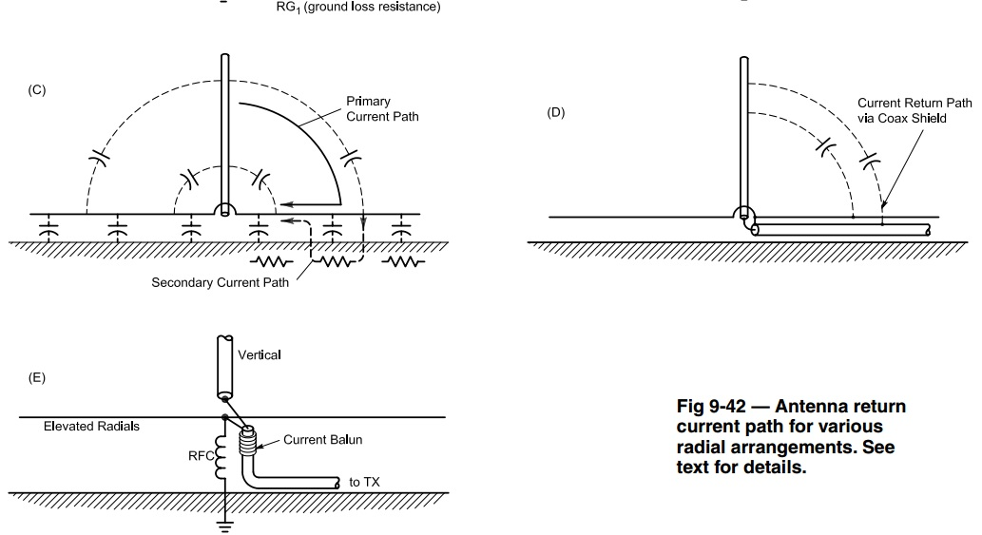
Antenna efficiency

Slide 35
Antenna efficiency
How raise radiation resistance?
  Large contributor within our control is height of vertical element
  The taller a vertical is the higher the radiation resistance
  Taller also has the desired trait of moving the current higher and away from the ground which reduces ground losses

Slide 36
Antenna efficiency
Maximum R_{rad} is ≈ 36Ω
Top loading has highest R_{rad}
Difference in R_{rad} between loading types only a couple ohms as approach ¼ wavelength high

Slide 37
Phasing Verticals
A yagi beam antenna has a driven element and other elements that direct or reflect the signal from it to give directionality and gain.
Verticals can work the same way. Space two or more at the right distance and phase them so their signals interact and give directionality. Each needs a good ground system though.

Slide 38
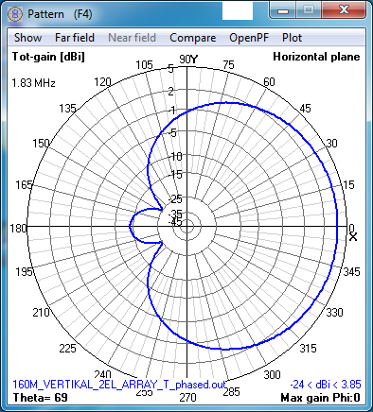
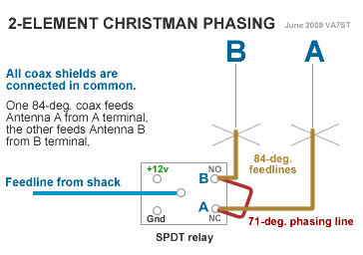
Phasing Verticals

Slide 39
Vertical Dipoles
Up to now we have talked about a “monopole” vertical
Vertical dipoles are far more independent of ground and have stronger signal strengths

Slide 40
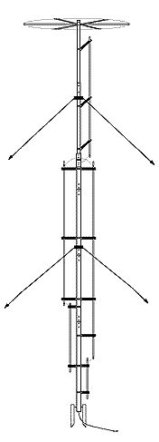
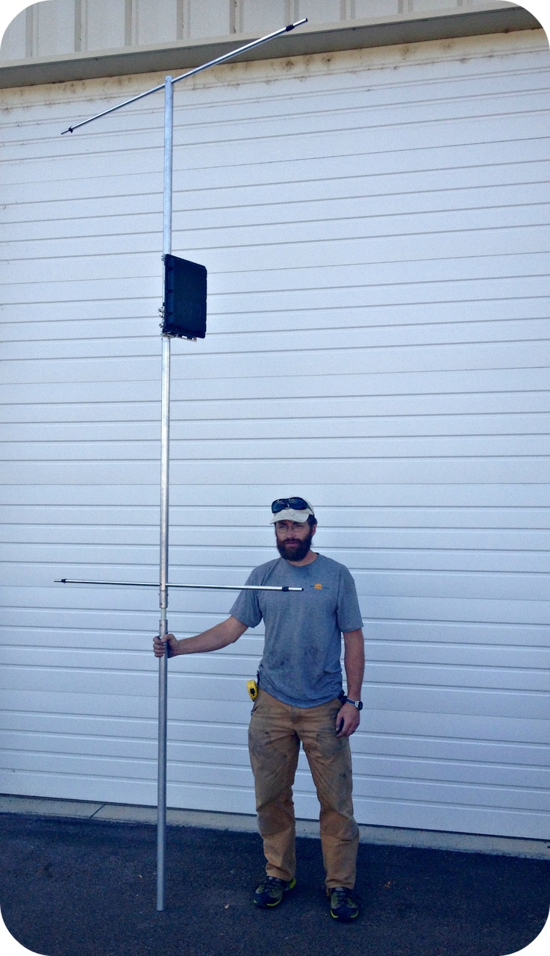
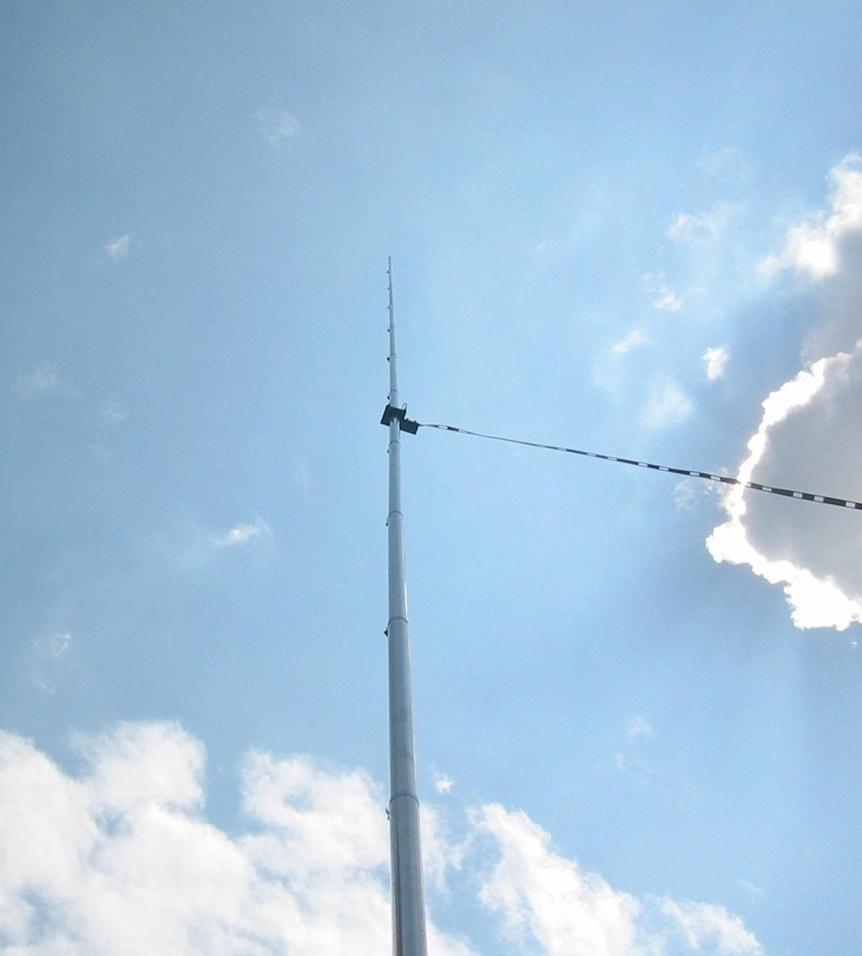
Vertical Dipoles

Slide 41
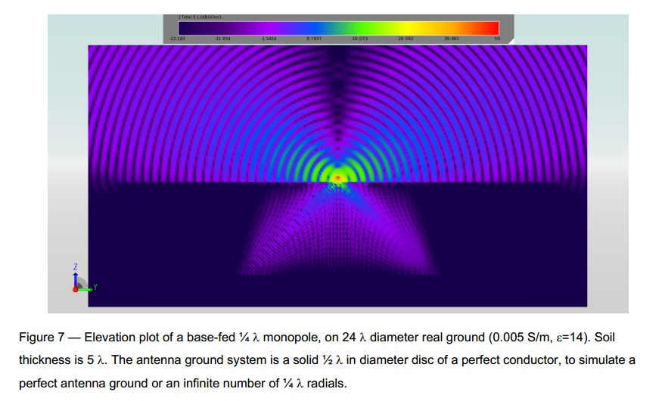
Vertical Dipoles

Slide 42
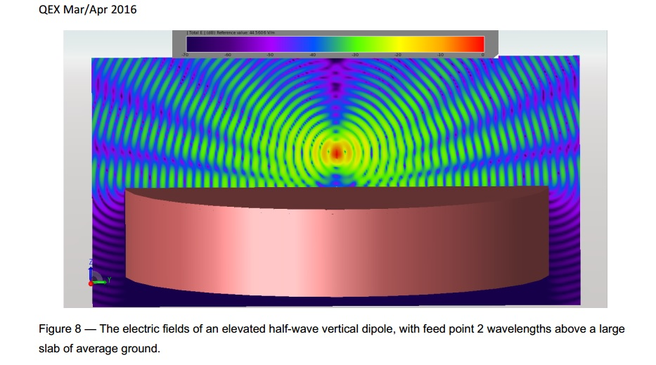
Vertical Dipoles

Slide 43
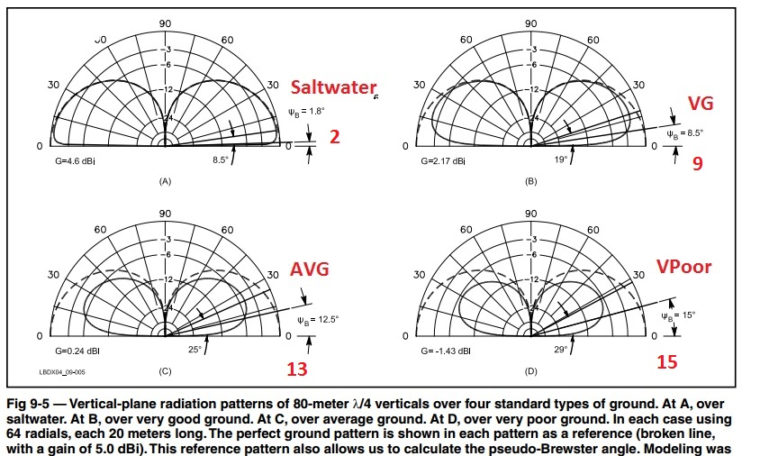
Pseudo-Brewster Angle
Type of ground determines the lowest angle you can get regardless of how tall it is or how many radials it has due to Near/Far field effects

Slide 44
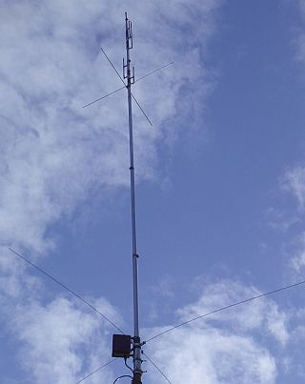
Radialess Verticals
Think of these as asymmetrical vertical dipoles
They have lower efficiency then ground mounted verticals
Have to be elevated to minimize ground losses

Slide 45
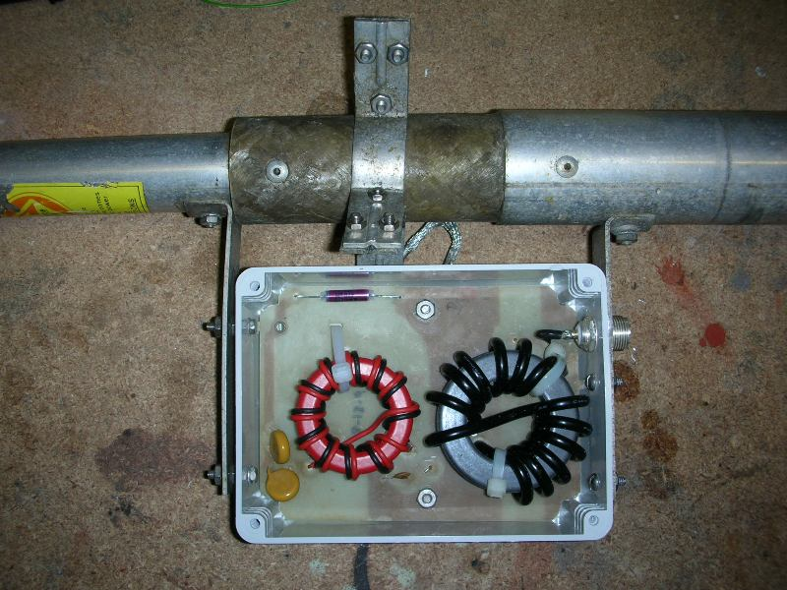
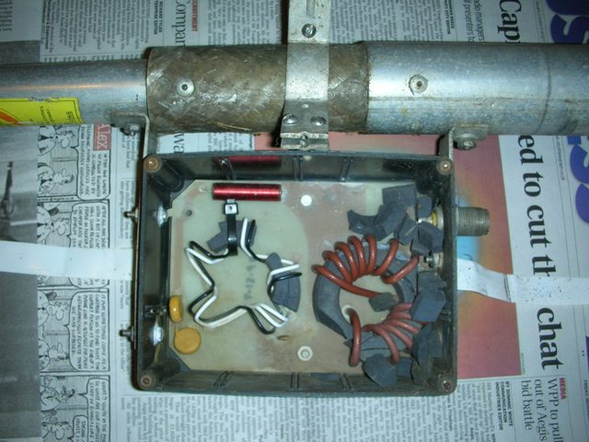
Radialess Verticals
Matching Network
Make antenna less efficient
Can’t handle much power with 100% duty cycle loads (like FM or RTTY/Digital modes)

Slide 46
The 43ft Vertical
Latest “flavor of the year” – but it is still a vertical antenna and what we just talked about applies
Earliest versions used voltage baluns instead of current or ununs. The antenna “looked” great to operator, but that significantly reduced radiated signal strength
Needs a matching network or tuner at base
Actually not very good low band or low angle performance compared to a single band monopole or vertical dipole

Slide 47
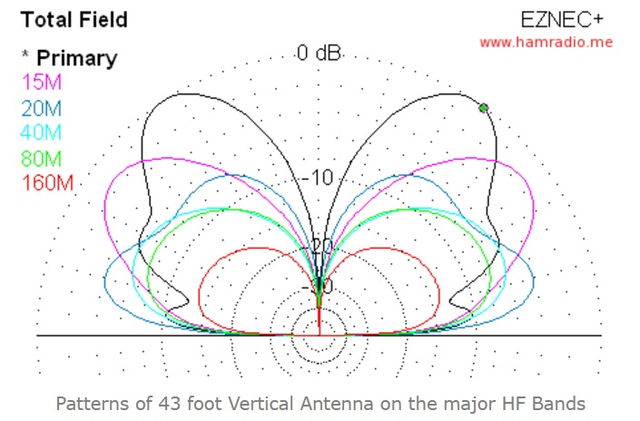
The 43ft Vertical
http://www.hamradio.me/antennas/answer-to-everything-43-feet-antenna.html

Slide 48
The 43ft Vertical
Quote by KE2IV
  QST is filled with ads from various manufacturers and suppliers offering "all-band" 43-foot verticals. Legitimately, all these ads make it clear that this (and any vertical) will require a good ground plane system of radials for effectiveness.
  But why 43-feet? What is the "formula" to explain why this length will effectively radiate on "all bands" (i.e. 160m - 10m) with a decent ground plane system?KE2IV
Reply from W8JI (excerpt)
  There is no reason, George. Somehow that number just popped up out of the blue, and then everyone started copying it.
  The initial 43 foot vertical had a balun that, through an error in design, drove the coax shield with RF. This error, in some cases, made the SWR very low from 160-10 meters. Hence the "160-10" meter stuff started.
  After an eHam thread, the company initially marketing the 43 foot vertical revised the voltage balun to an un-un, and then the SWR was not so good at all but the signal was better
http://www.arrl.org/forum/topics/view/235

Slide 49
Key Concepts
Verticals do help with DX on the low bands
For our ground conditions in South Carolina a dipole usually works better
At least 30 quarter wave radials if on ground
Elevated radials work very well
Taller vertical length is better
Vertical dipoles good – but not practical for low bands

Slide 50
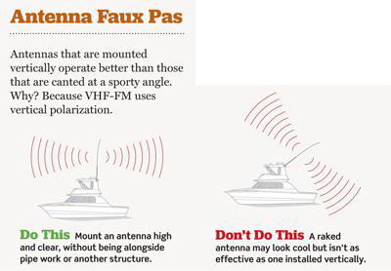
In passing
Don’t angle your VHF/UHF antennas

